Slide 1

Data Science 100 Principles & Techniques of Data Science
?
Slides by:
Deborah Nolan
deborah_nolan@berkeley.edu

Slide 2
Announcements for Today
We have asked for permission to increase the class size to enroll about 100 people from the wait list…. Stay tuned
We will try using Google forms today
Slides and notes from lecture available online at http://ds100.org/fa19
HW 1 is due 11:59 Wednesday Sep 4
Office hours are found at http://ds100.org/fa19/calendar

Slide 3
Data Life Cycle
?
Question
Formulation
Data Design/ Generation
Generalization
Data Analysis

Slide 4
START SIMPLE
QUESTION:
What is the typical family size (children only)?

Slide 5
START SIMPLE
DATA:
Survey of all 250 students enrolled in Data 100 in Fall 2017 and asked their family size
 | 1 | 2 | 3 | 4+
Counts | 61 | 131 | 44 | 14
Percent | 24% | 52% | 18% | 6%

Slide 6
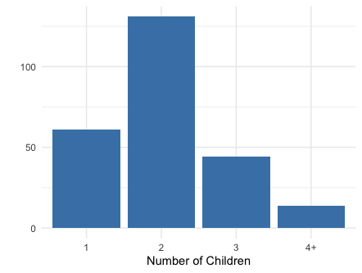
START SIMPLE
 | 1 | 2 | 3 | 4+
Counts | 61 | 131 | 44 | 14
Percent | 24% | 52% | 18% | 6%
ANALYSIS:
Can we provide a summary statistic?

Slide 7
DETOUR: Why is the sample mean such a desirable summary?

Slide 8

Summarizing the Data
DATA: $x_{1}, x_{2} , …, x_{n} \text{where} n \text{is}\text{ 250 }\text{in} \text{our} \text{example}$
ERROR: $x_{1}−c, x_{2}−c, …, x_{n}−c$
LOSS: $l:R→R^{+}$

Slide 9

Summarizing the Data
AVERAGE LOSS: $\frac{1}{n}\sum_{i=1}^{n}{l(x_{i} −c)}$
AKA EMPIRICAL RISK
Minimize the empirical risk

Slide 10
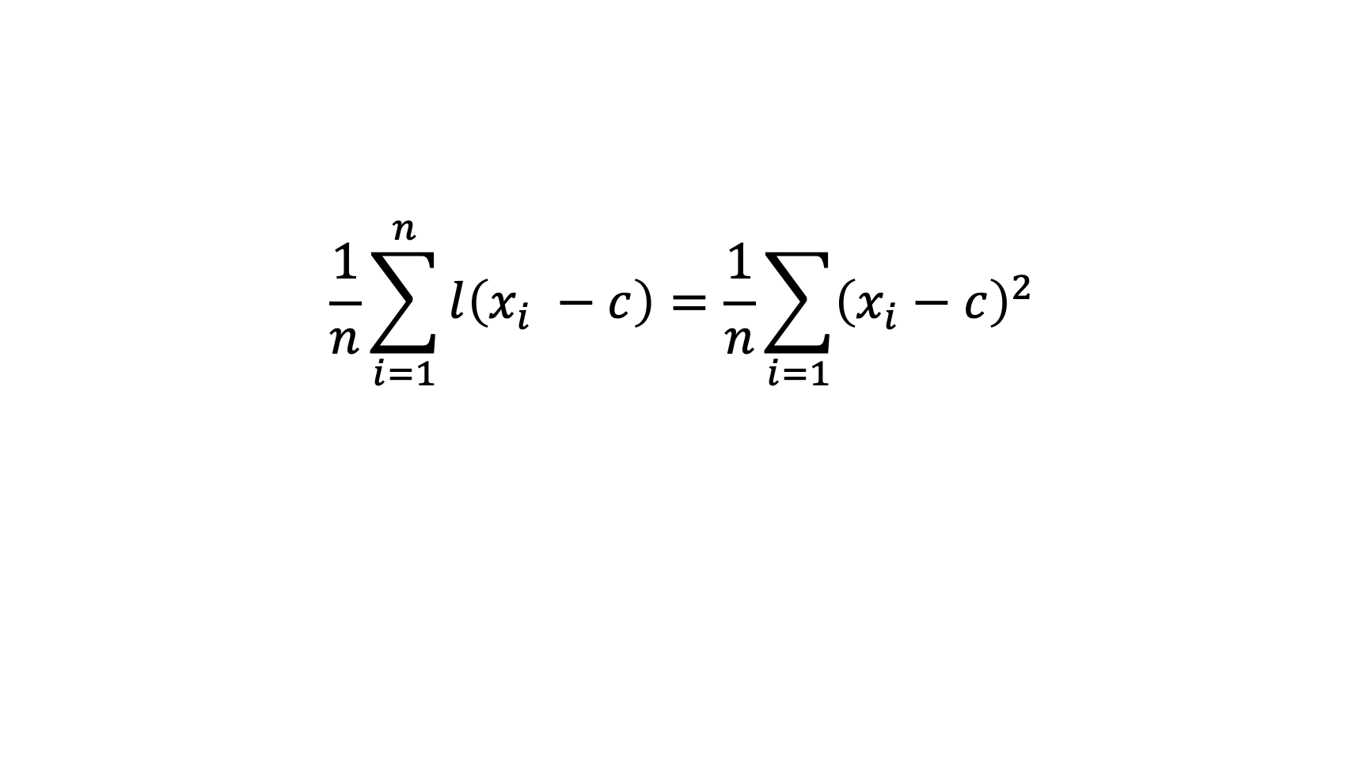
Minimize the Average Loss
$$\frac{1}{n}\sum_{i=1}^{n}{l\left(x_{i} −c\right)=\frac{1}{n}\sum_{i=1}{{\left(x_{i}−c\right)}^{2}}}$$

Slide 11
Refresher

Slide 12
Minimize the Average Loss

Slide 14
The Sample Average Minimizes Empirical Risk
This is the Sample Variance

Slide 15
Data Life Cycle
?
Question
Formulation
Data Design/ Generation
In some cases we do not want/need to Generalize
Data Analysis

Slide 16
Consider the Question Carefully
What is the typical family size (children only)?
How well can we
measure this?
What are we trying
to measure?

Slide 17
Focus the Question
From Female Fertility Perspective:
WHERE
WHEN
WHO
WHAT

Slide 18
Focus the Question
The Question gives focus to the Population that we want to study

Slide 19
Data Life Cycle
Data Design/ Generation
Get Data from the World and Generalize Data Findings to the world
Generalization

Slide 20
How Well Does our Data 100 class represent the group of interest?
Mothers of children at UC Berkeley
Measure the mothers via the children
Mothers who are 40-44 in 2014
How might these characteristics impact the estimate of the number of children a US woman bears in her lifetime in 2014?
Bias up, Bias Down, Not impact

Slide 21
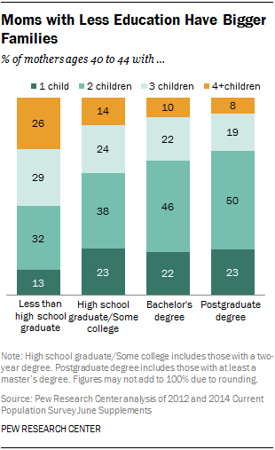
According to Pew Research Center
How might this impact the Data 100 average?
The data used in these analyses are designed to assess women’s fertility, and as such a “mother” is here defined as any woman who has given birth. However, many women who do not bear their own children are indeed mothers.
http://www.pewsocialtrends.org/2015/05/07/family-size-among-mothers/

Slide 22
Population of Interest

Slide 23
Population of Interest
Sampling
Frame
Access the Population through the Frame

Slide 24
Population of Interest
SAMPLE
Sampling
Frame
The Sample is a subset of the Frame

Slide 25
Sample = Sampling Frame = Population
Scenario: Census
SAMPLE
Sampling
Frame

Slide 26
Sampling Frame = Population
Scenario: Access to all members of the Population when sampling
SAMPLE
Sampling
Frame

Slide 27
Sampling Frame = Sample
Scenario: Administrative Data
SAMPLE
Sampling
Frame

Slide 28
Population of Interest
Most Common Scenario
SAMPLE
Sampling
Frame

Slide 29
How are the data generated?
What is the population of interest?
What is the sampling frame?
How are the data generated?

Slide 30
DETOUR: 1. The simple random sample 2. Why is a probability sample so desirable?

Slide 31
Sampling Frame = Population
Scenario: Access to all members of the Population when sampling
SAMPLE
Sampling
Frame
HOW IS THE SAMPLE TAKEN?

Slide 32
The Simple Random Sample
Suppose we have a population with N subjects
We want to sample n of them
The SRS is a random sample where every unique subset of n subjects has the same chance of appearing in the sample
This means each person is equally likely to be in the sample

Slide 33
The Advantages of a SRS
Representative: The sample tends to look like the population
Statistics based on the sample tend to be close to statistics based on the population
We can provide typical deviations of sample statistics from population values.
AND MORE…

Slide 34
Start Simple
Suppose our population contains only 10 mothers and we take a Simple Random Sample of 3 for our survey.
 | Number of Children
 | 1 | 2 | 3 | 4+
Count | 2 | 4 | 3 | 1
Proportion | 20% | 40% | 30% | 10%

Slide 35



Formal Set Up
 | Number of Children
 | 1 | 2 | 3 | 4+
Count | 2 | 4 | 3 | 1
Proportion | 20% | 40% | 30% | 10%
$X_{1}$ The number of children for the first mother chosen
$X_{2}$ The number of children for the second mother chosen
$X_{3}$ The number of children for the third mother chosen

Slide 36
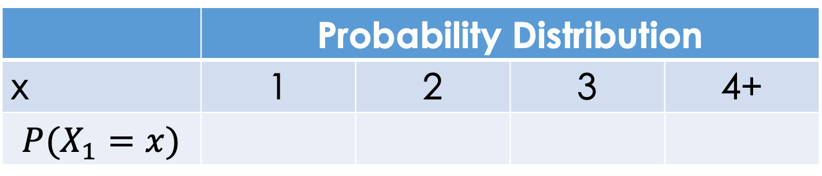

Formal Set Up
 | Number of Children
 | 1 | 2 | 3 | 4+
Count | 2 | 4 | 3 | 1
Percent | 20% | 40% | 30% | 10%
$X_{1}$ The number of children for the first mother chosen
 | Probability Distribution
x | 1 | 2 | 3 | 4+
$$P(X_{1}=x)$$

Slide 37
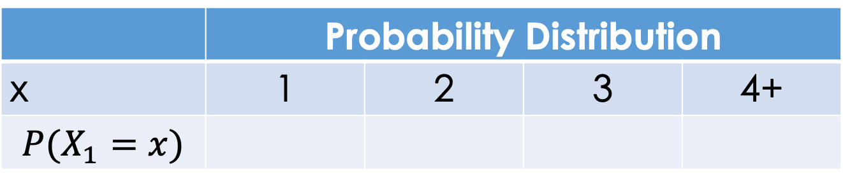
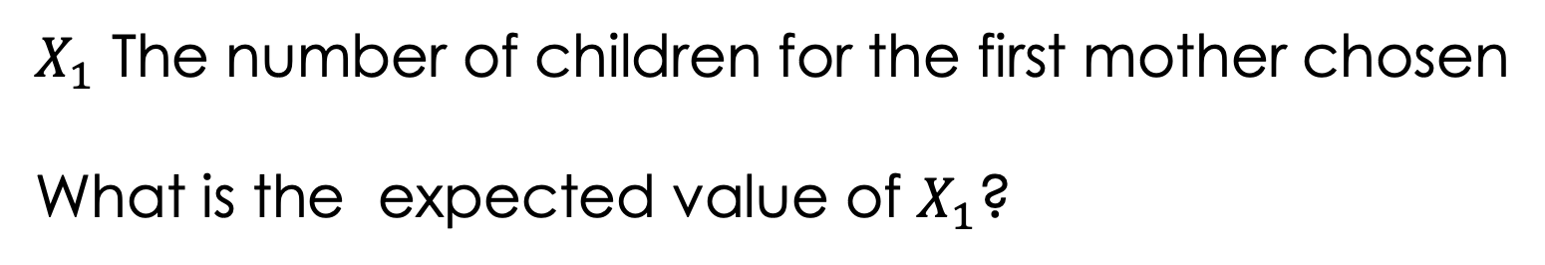
 | Probability Distribution
x | 1 | 2 | 3 | 4+
$$P(X_{1}=x)$$
$X_{1}$ The number of children for the first mother chosen
What is the expected value of $X_{1}$?

Slide 38


$X_{2}$ number of children for the 2nd mother chosen
 | Probability Distribution
x | 1 | 2 | 3 | 4+
$$P(X_{2}=x)$$

Slide 39
$X_{2}$ number of children for the 2nd mother chosen

Slide 40
DETOUR CONTINUED: Why is the expected value a desirable summary of a probability distribution?

Slide 41

Random Variables
Random Variables: $X_{1}, X_{2} , …, X_{n}$
Random ERROR: $X_{1}−c, X_{2}−c, …, X_{n}−c$
LOSS: $l:R→R^{+}$

Slide 42
Summarizing the Probability Distribution
EXPECTED LOSS:
AKA RISK
Minimize the risk

Slide 43
Properties of Expected Value

Slide 44
Minimize the Risk

Slide 46
The Expected Value Minimizes Risk
This side is the Variance

Slide 47
Data Life Cycle
Data Design/ Generation
Probability Samples give us Representative Data where the sample average is well behaved and an accurate estimate of the population average
Generalization

Slide 48
Sampling Frame = Sample
Scenario: Administrative Data
SAMPLE =
Sampling
Frame

Slide 49
Can we make up for no Probability Sample with Big Data?

Slide 50
Sample and Population Averages
The gap between these is based on three things:
Data quality measure (the correlation between the sampling technique and the response)
Data quantity measure (how big is the sample relative to the population)
Problem difficulty measure (how variable is the response)
Meng 2018, Annals Applied Probability

Slide 51
Sample and Population Averages
Probabilistic sampling ensures high data quality by eliminating selection bias and confounding
When combining data sources for population inferences, those relatively tiny but higher quality sources should be given far more weights than suggested by their sizes.
Active Area of Research Area

Slide 52
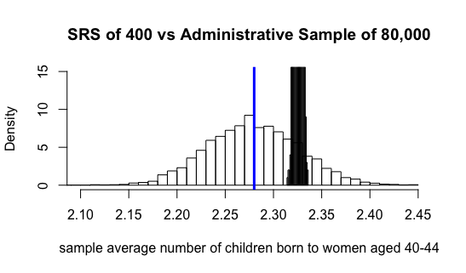
Large Administrative Data vs Small SRS

Slide 53
Data Life Cycle
?
Question
Formulation
Data Design/ Generation
Generalization
Data Analysis

